Slide 1
Provider Enrollment Workshop
Conduent
Government Healthcare Solutions

Slide 2
Purpose
The purpose of this workshop is to provide an overview of the enrollment process and maintenance of accurate provider records. Understanding these processes will improve the timeliness of obtaining and maintaining your active provider status with New Mexico Medicaid.

Slide 3
Objectives
We will review the following:
New Mexico Web Portal Information and Enhancements
Web Portal Application Submission Process
Application Tips
Return to Provider (RTP)
Turn Around Documents (TAD)
Update Requests

Slide 4
New Mexico Web Portal Information and Enhancements
Conduent
Government Healthcare Solutions

Slide 5
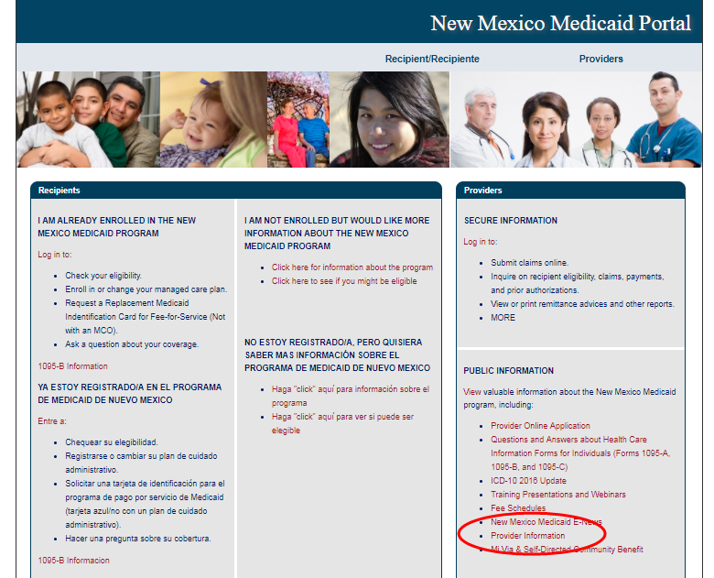
New Mexico Web Portal Information and Enhancements

Slide 6
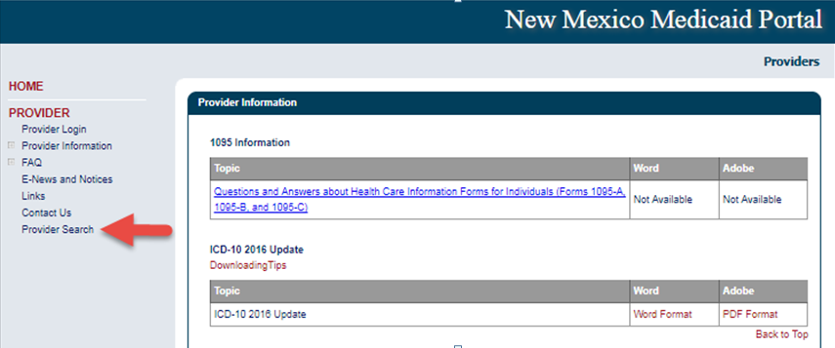
New Mexico Web Portal Information and Enhancements

Slide 7
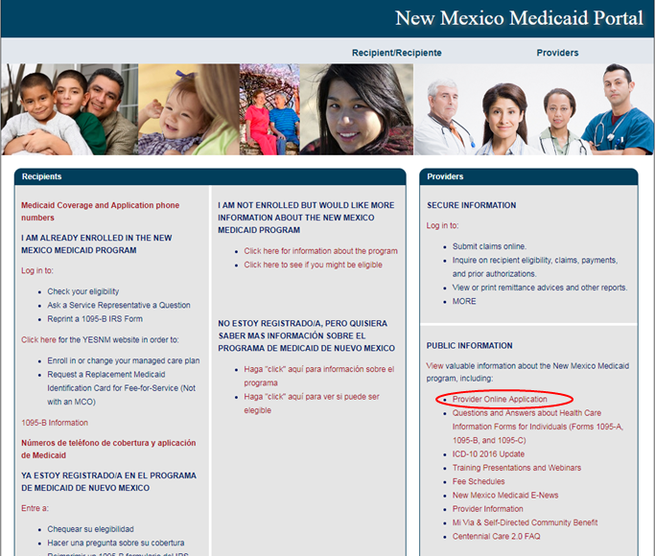
New Mexico Web Portal Information and Enhancements
Notes:
Speaker Note: Users can also access Provider Search from the Check Enrollment Status option.

Slide 8
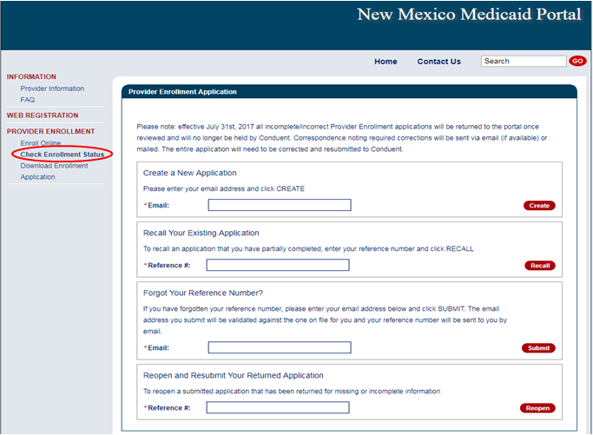
New Mexico Web Portal Information and Enhancements
Notes:
Click on Check Enrollment Status

Slide 9
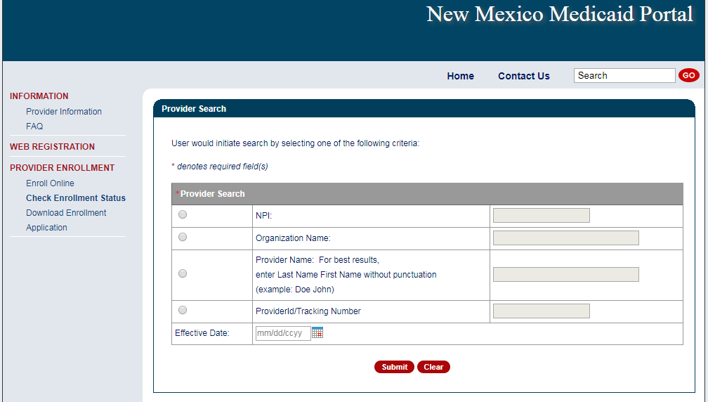
New Mexico Web Portal Information and Enhancements
Notes:
Speaker Notes: New fields are
Provider ID/Tracking Number
User can enter either a Medicaid Provider ID or a Provider Enrollment Application Tracking Number
Effective Date
User can enter a specific date of service or leave the field blank
If date field is left blank, search will default to “today’s date” or the date the search is launched.
Results changes are:
Enrollment Status results will now include RTP and terminated status codes
Multiple results can appear simultaneously
Provider records without NPI will appear in the results

Slide 10
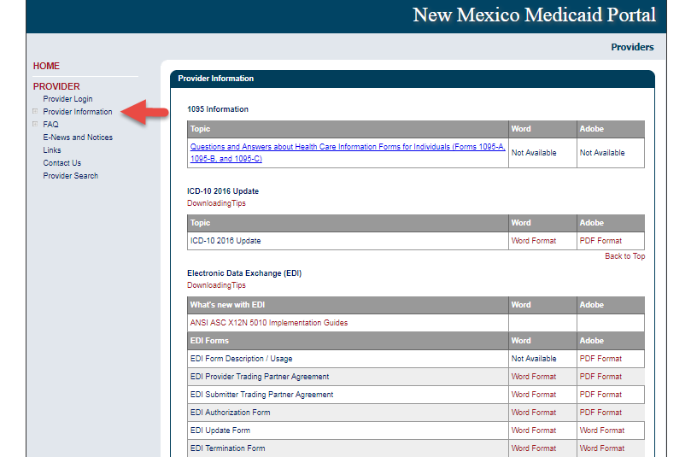
New Mexico Web Portal Information and Enhancements

Slide 11
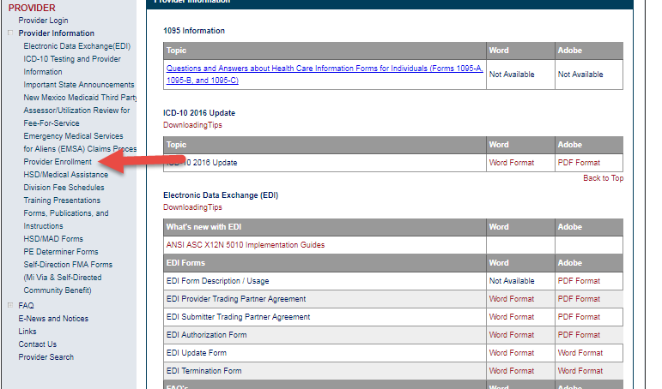
New Mexico Web Portal Information and Enhancements

Slide 12
Web Portal Application Submission Process
Conduent
Government Healthcare Solutions

Slide 13
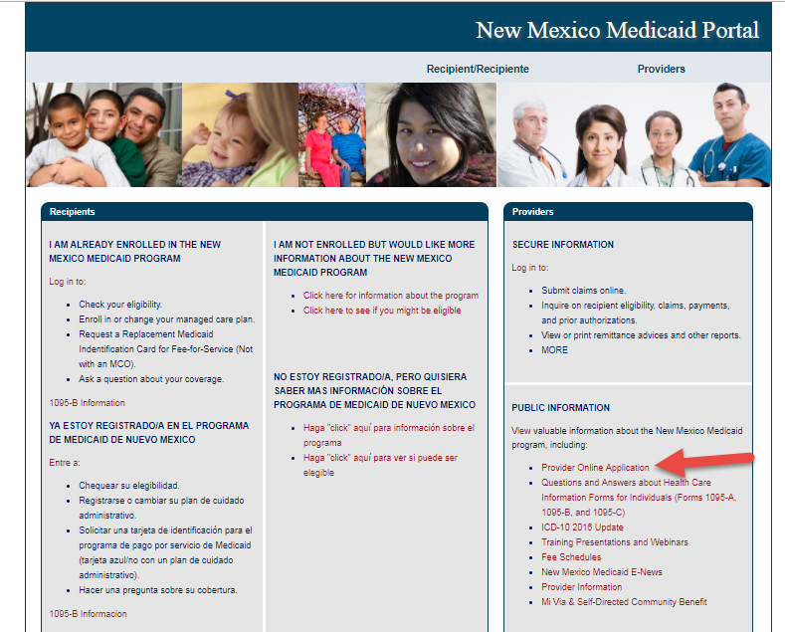
NM Medicaid Web Portal Application Location
https://nmmedicaid.portal.conduent.com/webportal/enrollOnline

Slide 14
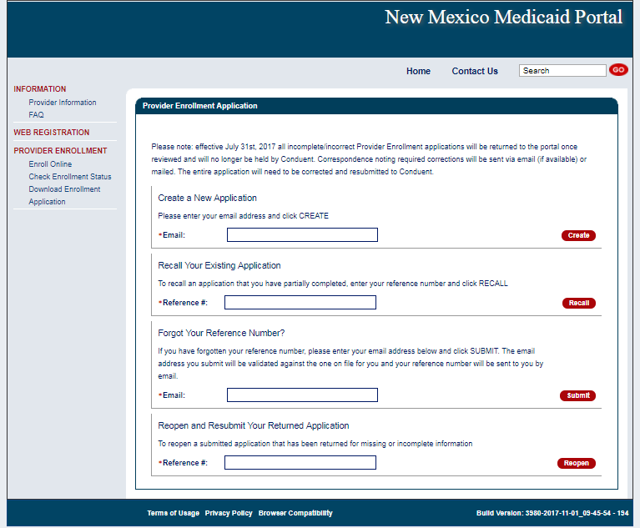
Provider Enrollment Application Initial Screen

Slide 15
Provider Enrollment Application Initial Screen
Begin your application by entering your email

Slide 16
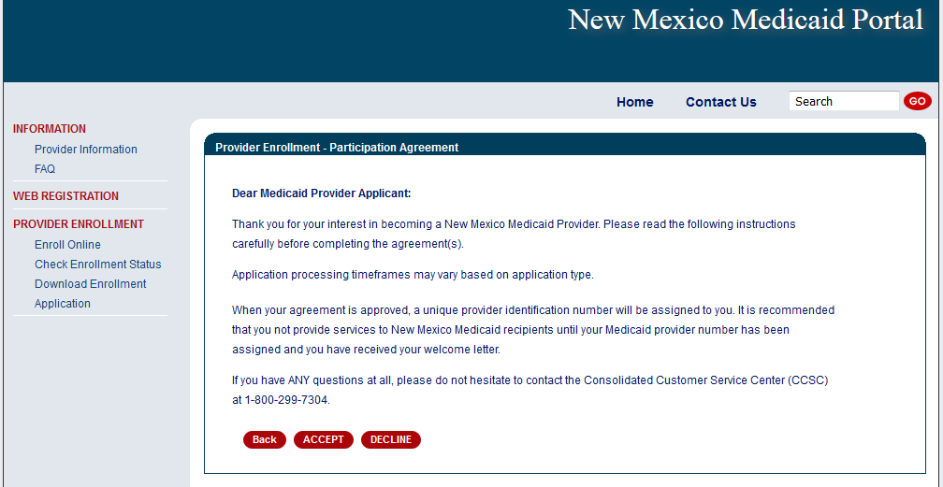
Provider Participation Agreement (Application)

Slide 17
Selecting the Right Application Form
MAD 335 - Medicaid Provider Participation Agreement for groups, organizations, facilities, or individual applicants to whom payments will be made (including CSAs, FQHCs, Hospitals, Pharmacies, etc.)
MAD 312 - Medicaid Provider Participation Agreement for individual applicant within group (including Psychologists, MDs, CNPs, LCSWs, LMHCs, etc.)
Please review the Provider Type and Specialty List for a complete list of documents that must be included with the Application, as well as applicable enrollment restrictions

Slide 18
Provider Type & Specialty List

Slide 19
Online Provider Enrollment Features
Reminder: After your application has been approved, Providers that wish to see managed care recipients must also contact each of the Centennial Care MCOs and follow their instructions for the credentialing and/or contracting process with them.
Centennial Care MCOs | Contact Number | Website
BlueCross BlueShield of New Mexico | (866) 689-1523 | www.bcbsnm.com/community-centennial/
Presbyterian | (888) 977-2333 | www.phs.org
Western Sky Community Care | (844) 543-8996 | www.westernskycommunitycare.com

Slide 20
Web Portal Application Submission Process – MAD 312
Conduent
Government Healthcare Solutions

Slide 21
Web Portal Application Submission Process – MAD 312
MAD 312 applications are used to enroll individuals who perform services within a group or organization
Select either:
Fee-For-Service (FFS) and Managed Care Organization (MCO) network or Fee-For-Service (FFS) only.
Managed Care Organization (MCO) Only
Click on “initial enrollment” and “continue”

Slide 22
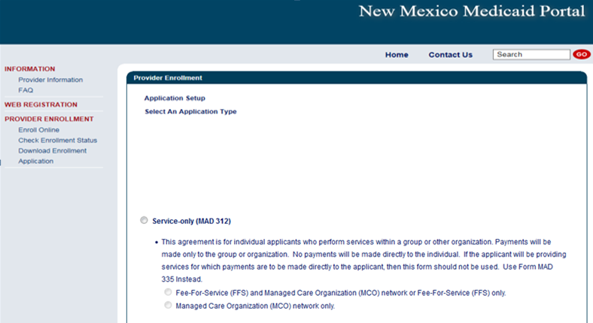
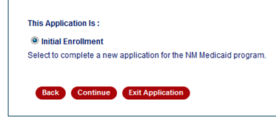
Web Portal Application Submission Process – MAD 312

Slide 23
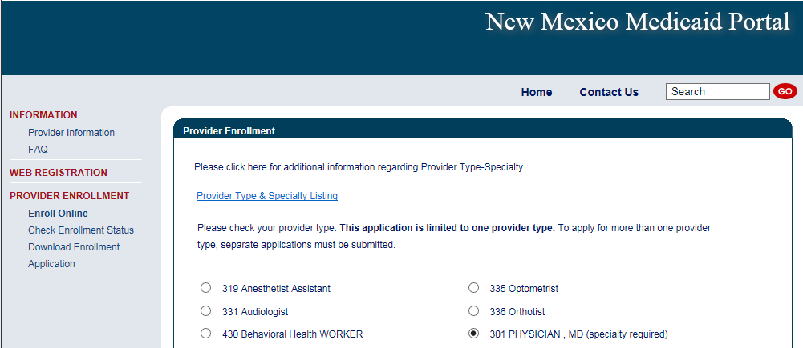
Web Portal Application Submission Process – MAD 312
Choosing a provider type: Use the Provider Type & Specialty Listing link on the portal to view your provider type and the required documentation associated with that provider type.

Slide 24
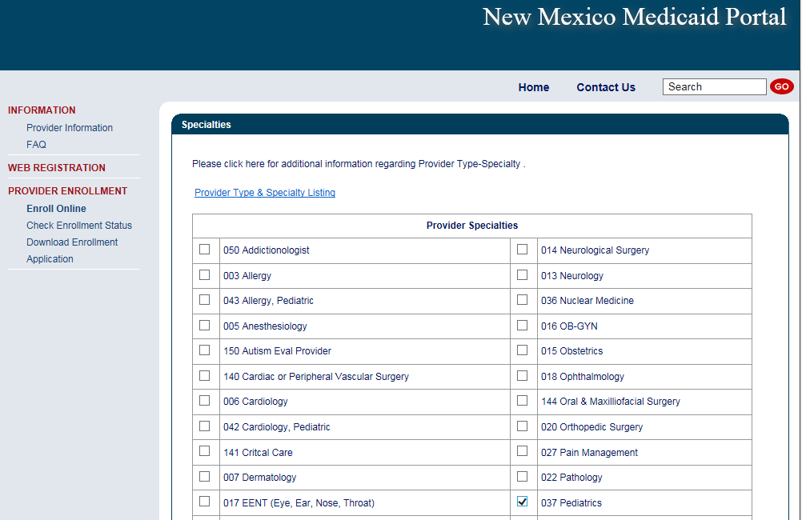
Web Portal Application Submission Process – MAD 312
Please click on the specialty being requested
Note: not all provider types require a specialty

Slide 25
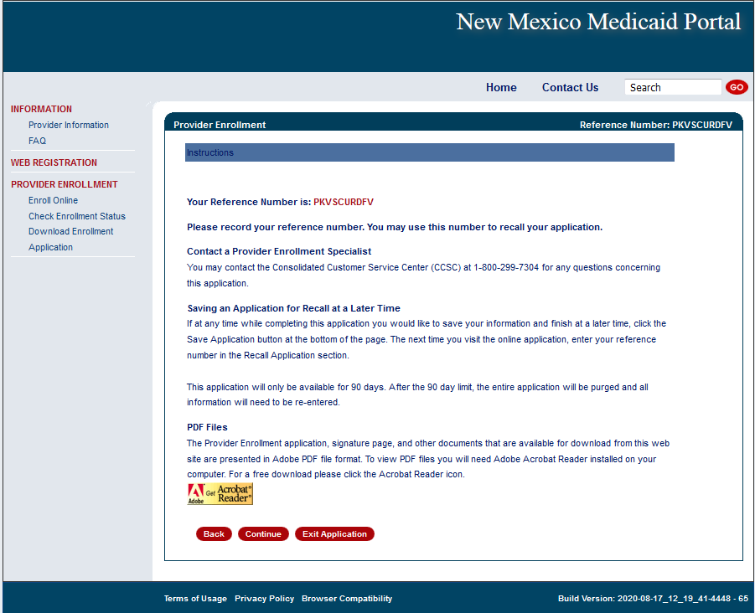
Web Portal Application Submission Process – MAD 312
Please take note of your Reference Number. This will be the number you use to retrieve the application later.

Slide 26
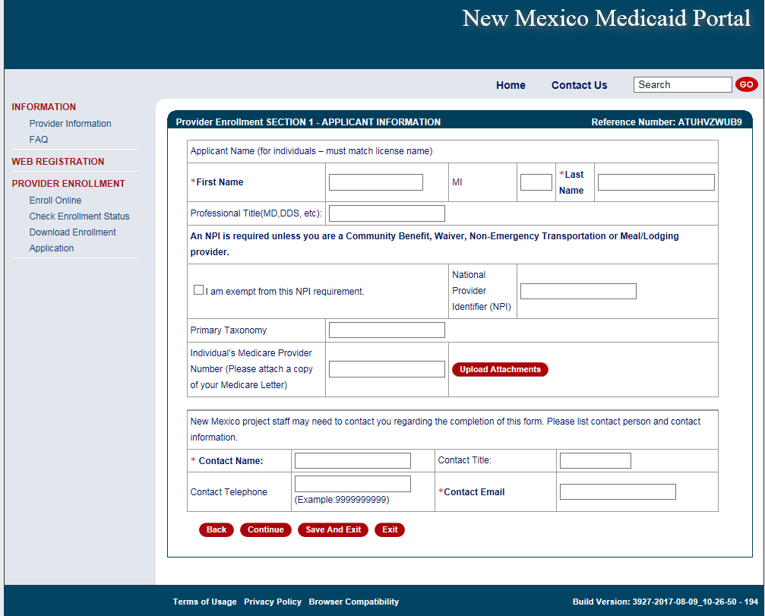
Web Portal Application Submission Process – MAD 312
The provider’s name, NPI, Medicare Number (if applicable), and a contact person is entered here.

Slide 27
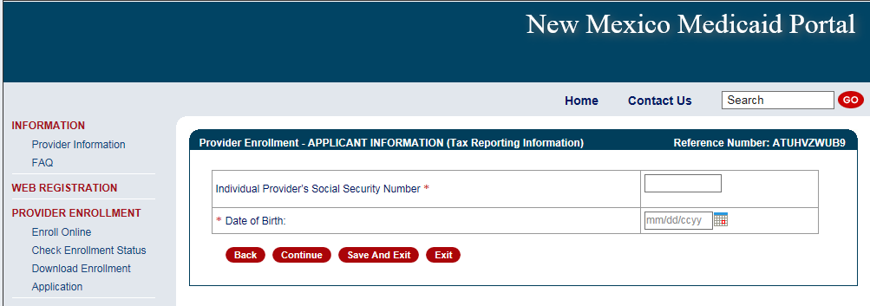
Web Portal Application Submission Process – MAD 312

Slide 28
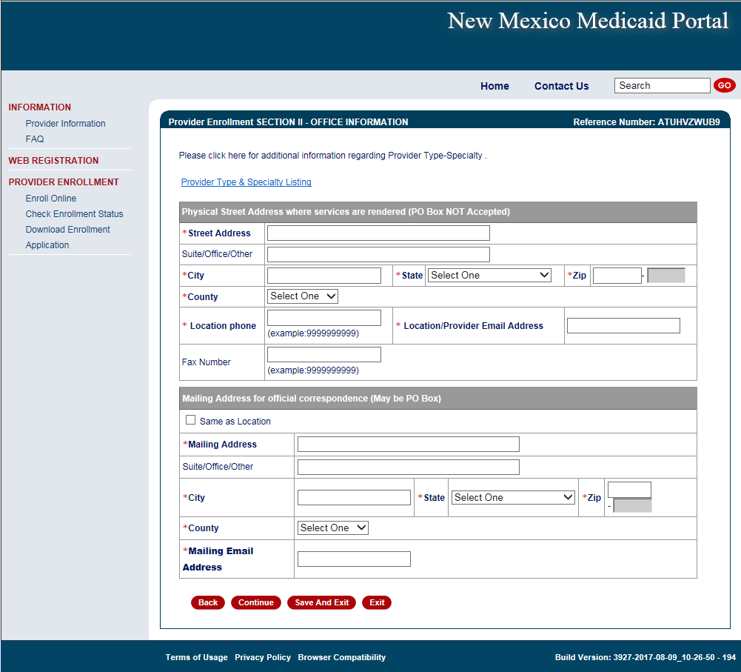
Web Portal Application Submission Process – MAD 312
Practice location address and mailing address are both required

Slide 29
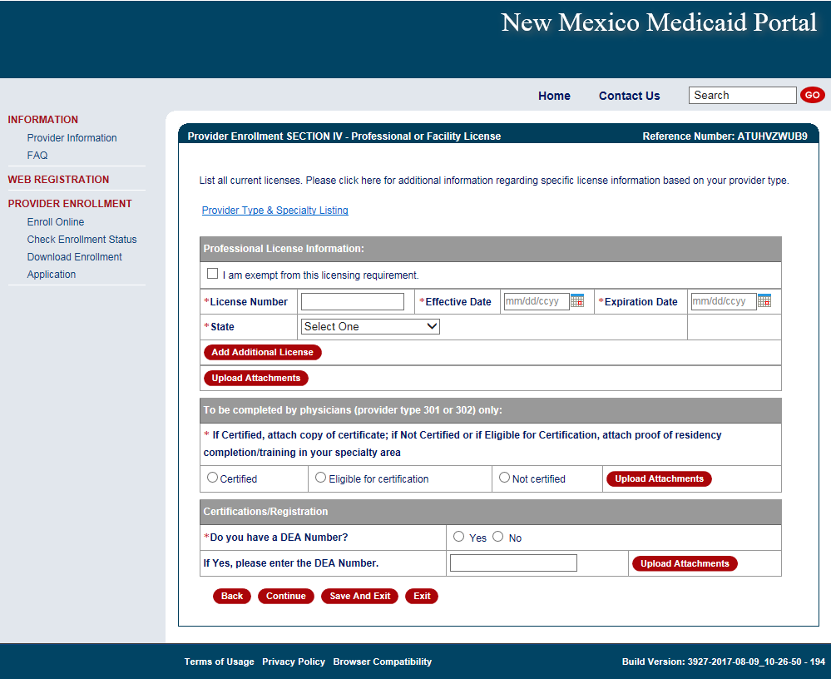
Web Portal Application Submission Process – MAD 312
The State issuing the professional license and the State in which the provider is practicing must match (with the exception of providers affiliating with IHS)
Note: Telemedicine providers should submit professional license from their home state (not Telemedicine license alone)
Notes:
Mention certification website for providers to get effective dates for providers only to obtain.

Slide 30
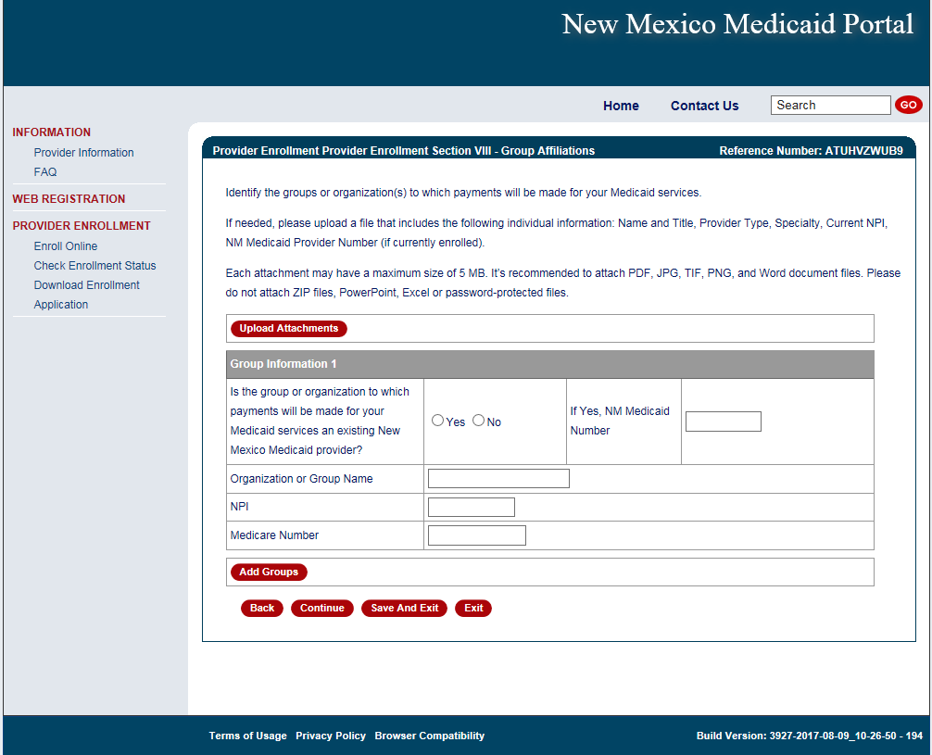
Web Portal Application Submission Process – MAD 312
Enter billing group information

Slide 31
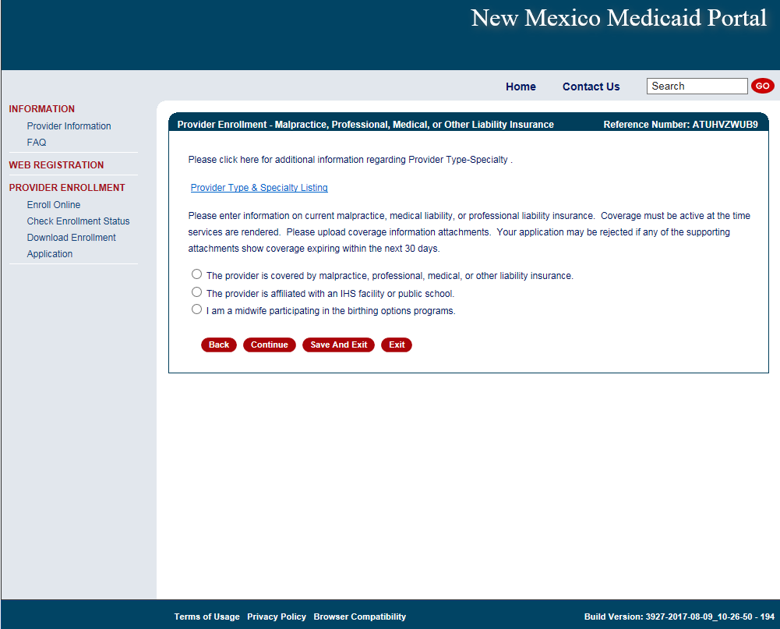
Web Portal Application Submission Process – MAD 312
Select professional liability type
Notes:
If you are a midwife participating in the birthing options program be sure to also submit supplemental agreement and affidavit of insurance.

Slide 32
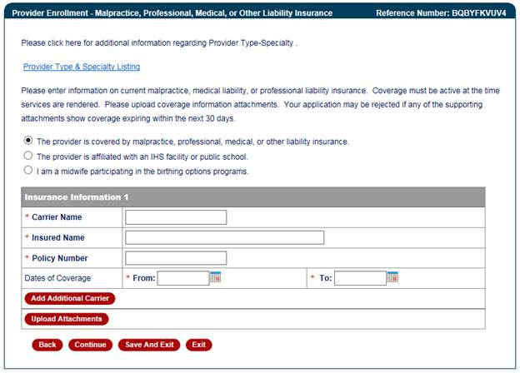
Provider Enrollment Application
Attach proof of professional liability if applicable
Attach proof of professional liability

Slide 33
Web Portal Application Submission Process – MAD 335
Conduent
Government Healthcare Solutions

Slide 34
Web Portal Application Submission Process – MAD 335
MAD 335 applications are used to enroll providers to whom payment will be made
Select either:
Fee-For-Service (FFS) and Managed Care Organization (MCO) network or Fee-For-Service (FFS) only.
Managed Care Organization (MCO) Only
Click on “initial enrollment” and “continue”

Slide 35
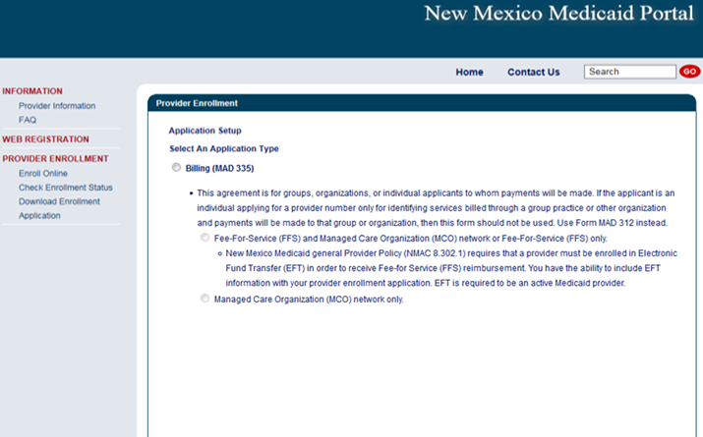
Web Portal Application Submission Process – MAD 335

Slide 36
Web Portal Application Submission Process – MAD 335
Choosing a provider type: Use the Provider Type & Specialty Listing link on the portal to view your provider type and the required documentation associated with that provider type.

Slide 37
Web Portal Application Submission Process – MAD 335
Click on the specialty being requested
Note: not all provider types require a specialty

Slide 38
Web Portal Application Submission Process – MAD 335
Take note of your Reference Number. This will be the number you use to retrieve the application later.

Slide 39
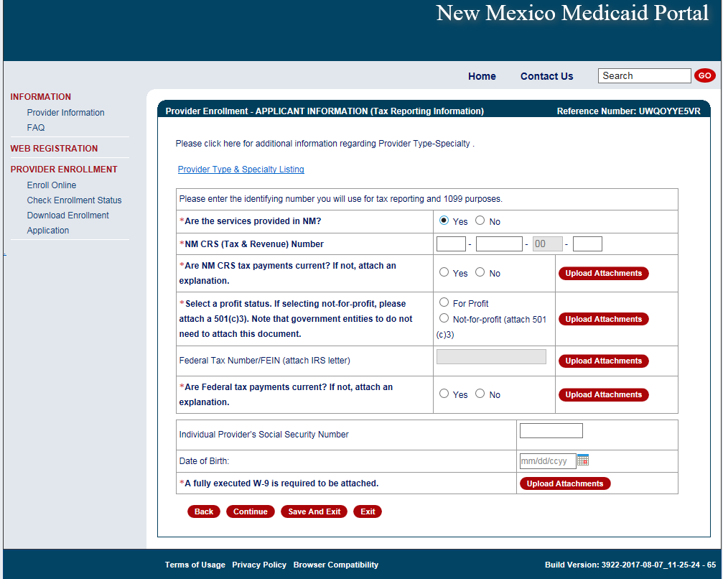
Web Portal Application Submission Process – MAD 335
If services are provided in NM, a CRS number is needed
Only one type of tax identification number can be added to this page (either Employer Identification Number or Social Security Number, not both)

Slide 40
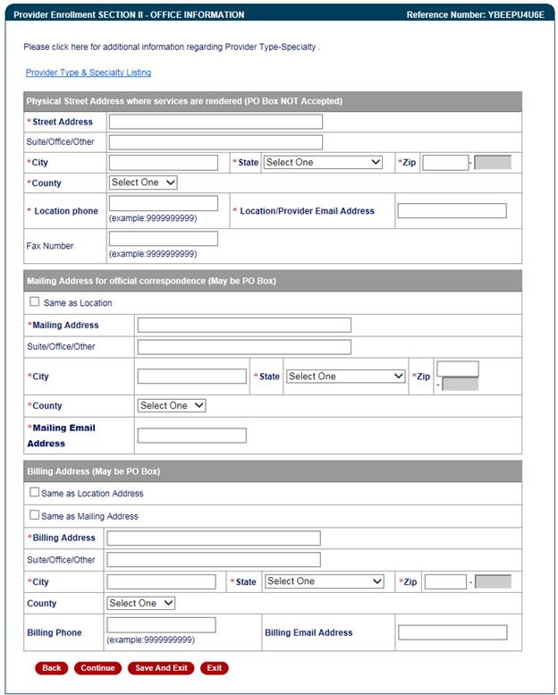
Web Portal Application Submission Process – MAD 335
Practice location address, mailing and billing address are required

Slide 41
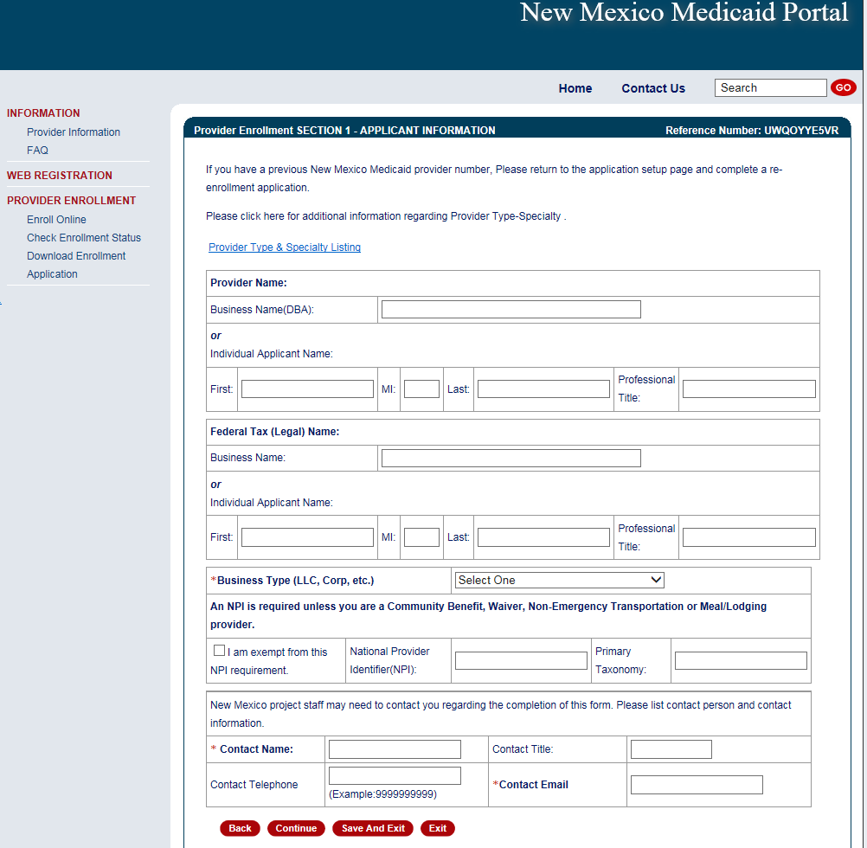
Web Portal Application Submission Process – MAD 335
Enter business name or individual name
Note: Type 1 NPIs are assigned to individual providers, and Type 2 NPIs are assigned to organizational providers
Notes:
If you are using a federal tax ID we expect a Type 2 NPI.

Slide 42
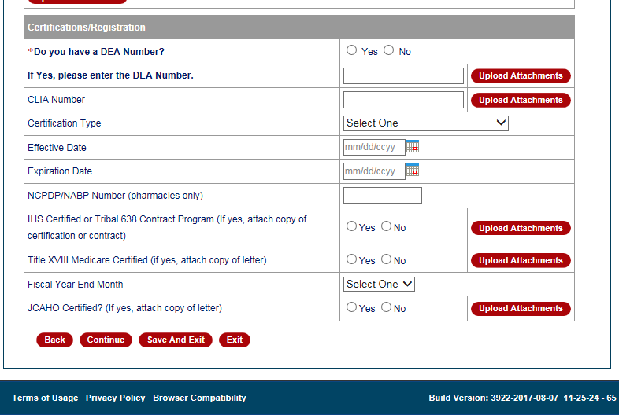
Web Portal Application Submission Process – MAD 335
Select and upload attachments that pertain to your provider type and specialty

Slide 43
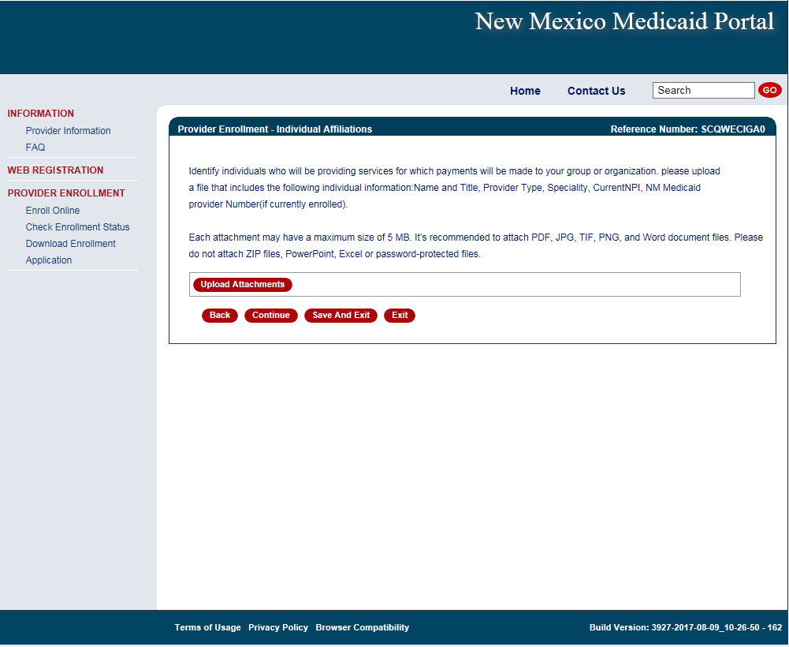
Web Portal Application Submission Process – MAD 335
Enter any/all providers that are rendering services for your group

Slide 44
Web Portal Application Submission Process – MAD 335
Select professional liability type
Notes:
If you are a midwife participating in the birthing options program be sure to also submit supplemental agreement and affidavit of insurance.

Slide 45
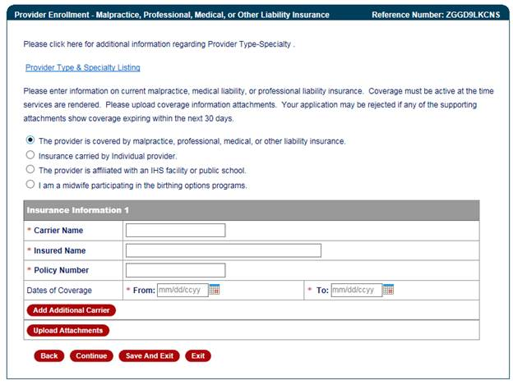
Web Portal Application Submission Process – MAD 335
Attach proof of professional liability if applicable
Attach proof of professional liability

Slide 46
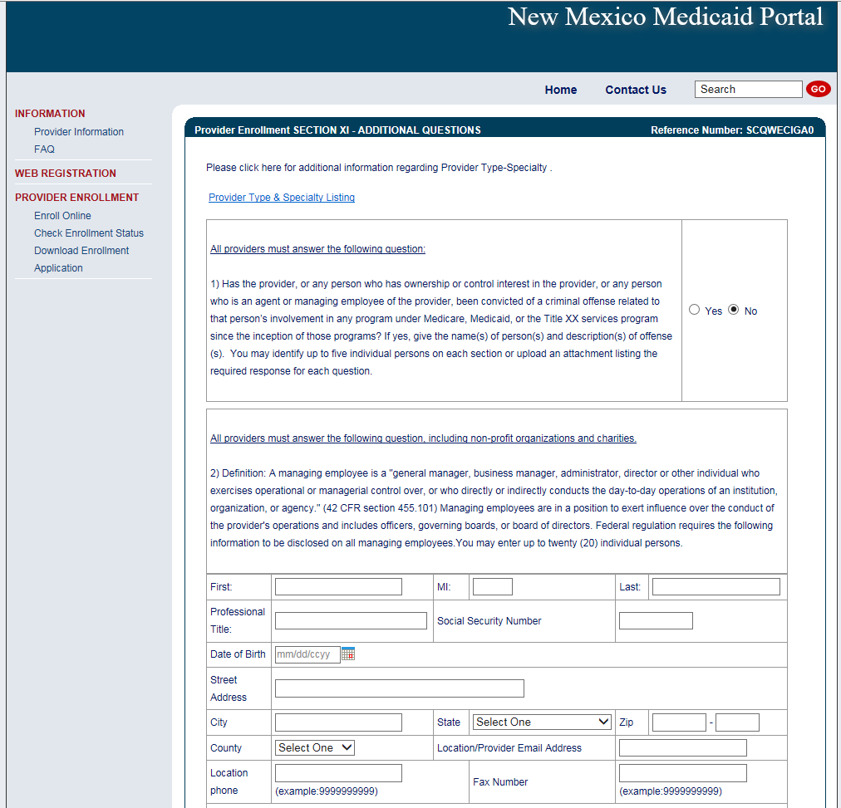
Web Portal Application Submission Process – MAD 335
All Managing Employees must be disclosed

Slide 47
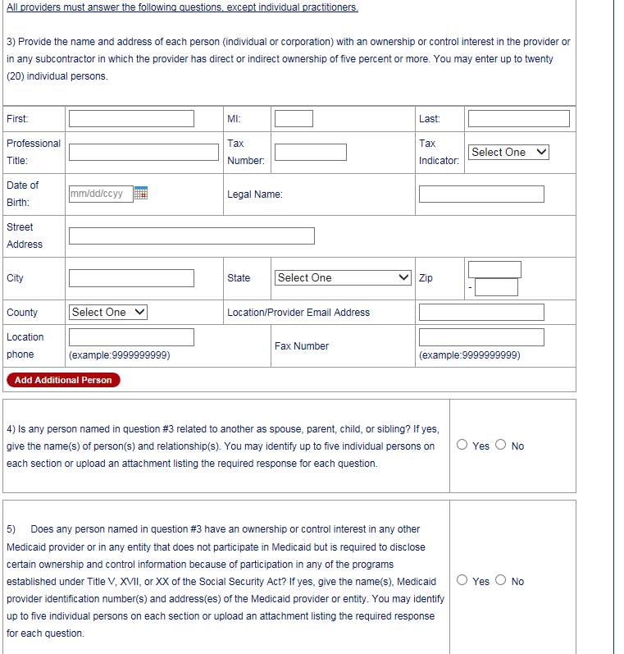
Web Portal Application Submission Process – MAD 335
Applicants must disclose any ownership of 5% or more

Slide 48
Web Portal Application Submission Process – Continued for both MAD 312 and MAD 335
Conduent
Government Healthcare Solutions

Slide 49
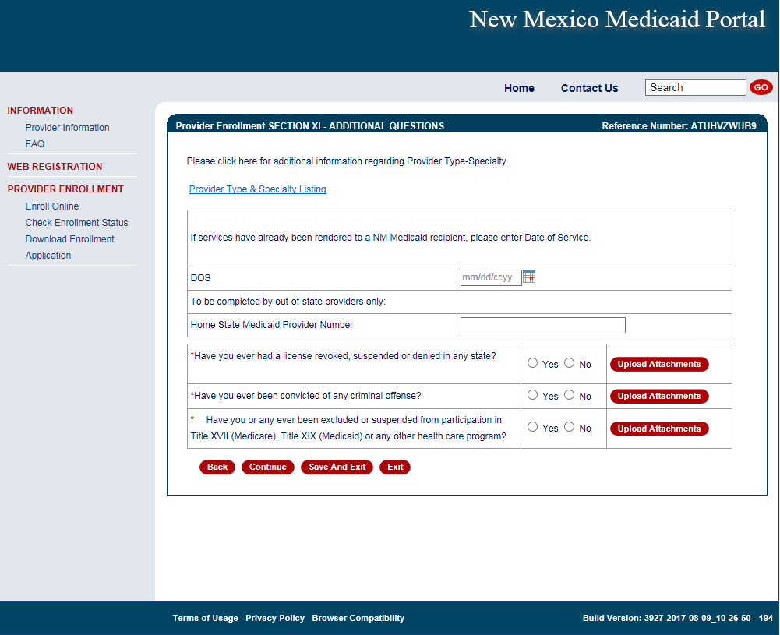
Provider Enrollment Application
Any “yes” answers to questions require supporting documentation
Note: If services were rendered to a Medicaid recipient before application approval, ensure dates on all attached documents (license, board cert, insurance) encompass all the Date(s) of Service and are valid for at least 30 days from application submission date.

Slide 50
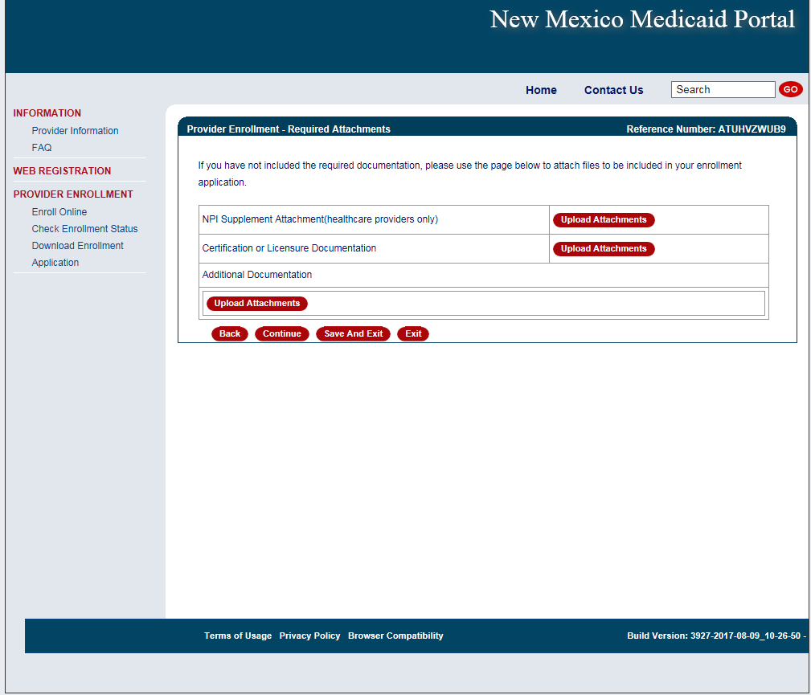
Provider Enrollment Application
Any additional documentation as required by the provider type and specialty list should be uploaded

Slide 51
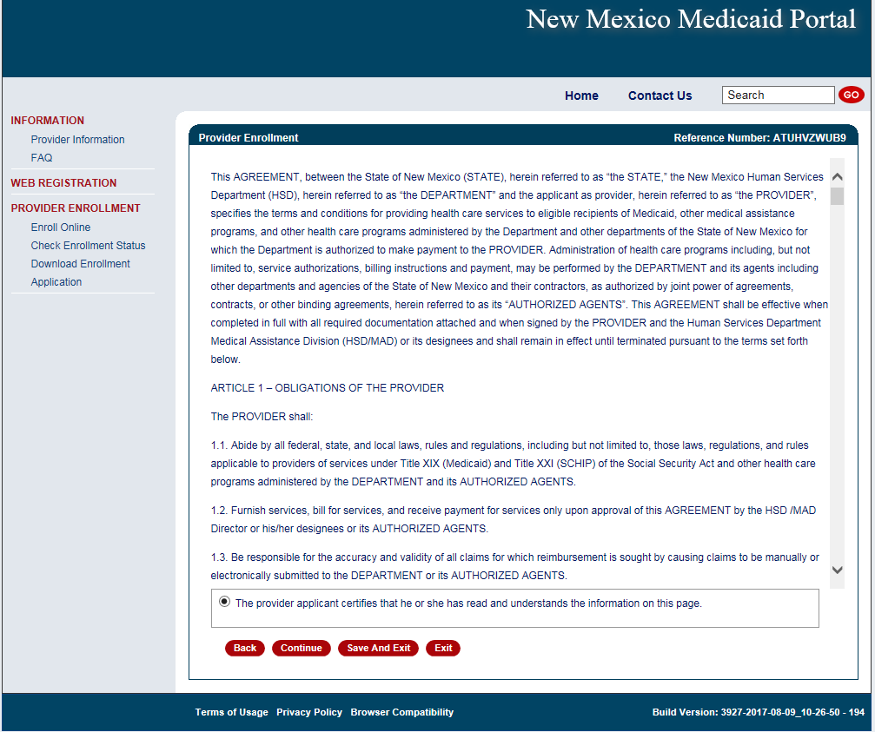
Provider Enrollment Application
Notes:
If you are filling out this application on behalf of a provider, the provider MUST read and agree to these terms.

Slide 52
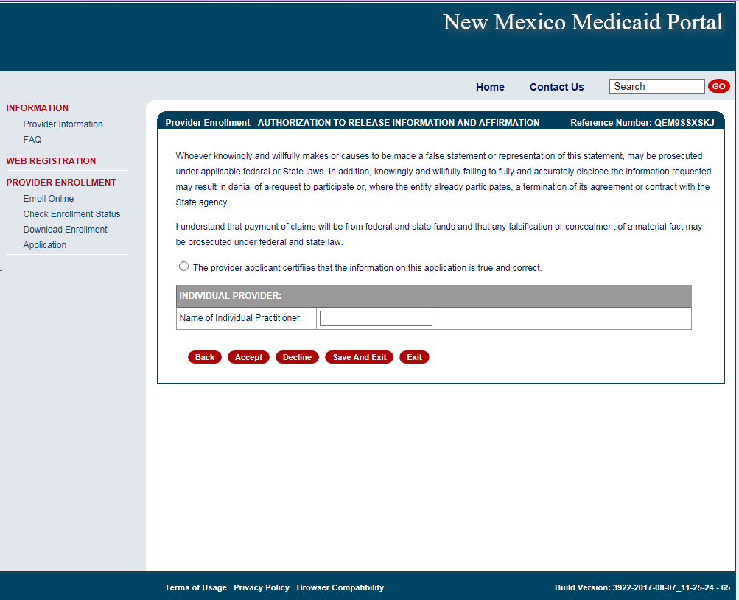
Provider Enrollment Application
Electronically sign here to acknowledge application is true and correct

Slide 53
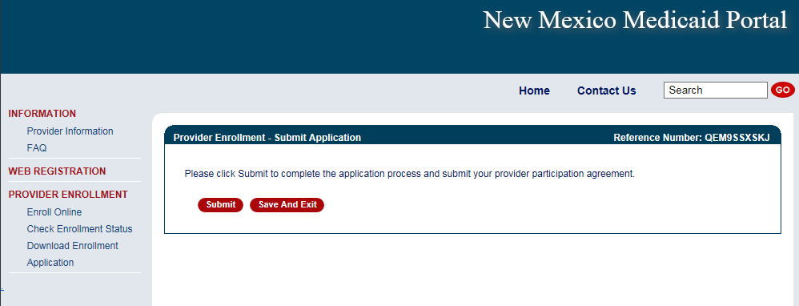
Provider Enrollment Application

Slide 54
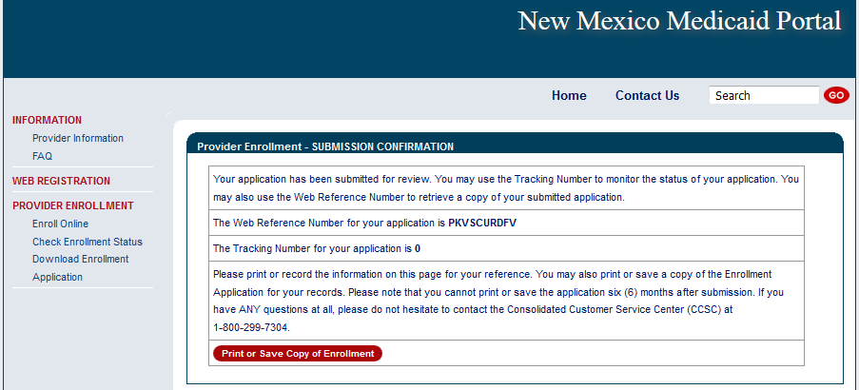
Provider Enrollment Application
Congratulations! Your application has been submitted. Be sure to keep your reference number, tracking number, and correspondence number.

Slide 55
Provider Enrollment Application Initial Screen
Recall Your Existing Application section:
If a provider left an application incomplete and did NOT submit it at all, you will have 90 days to recall the application, complete it, and submit via the portal.
If you forgot your reference number, enter your email and click submit.

Slide 56
Application Tips
Conduent
Government Healthcare Solutions

Slide 57
Provider Enrollment Applications Top Errors
Expired License or Insurance
Tip: To ensure processing is not delayed, validate that the license or Certificate of Insurance (COI) expiration dates is greater than 30 calendar days from the day Conduent receives your application.
Incorrect National Provider Identification Number (NPI)
Note: Applications using a Social Security Number (SSN) need a Type 1 NPI, and applications using a Federal Employer Identification Number (FEIN) need a Type 2 NPI.
Tip: We recommend visiting the National Plan and Provider Enumeration System (NPPES) website to ensure the correct NPI is entered on the application. The NPPES website is listed directly below:
https://npiregistry.cms.hhs.gov/
Notes:
Disclosure notice – a pending application does not guarantee activation.

Slide 58
Provider Enrollment Applications Top Errors Continued
Incomplete or Missing Information – IRS Letter/W-9 or Approval Letters
Tip: We recommend you refer to the Provider Type and Specialty List before submitting your application in order to review the required attachments for your specific provider type.

Slide 59
Return to Provider
Conduent
Government Healthcare Solutions

Slide 60
Return to Provider
If an application contains errors and/or missing/incorrect documentation, the provider will receive timely notification (via email) detailing the corrections needed before resubmitting the complete application to Conduent for review
This process is referred to as “Return to Provider” (RTP)

Slide 61
Return to Provider
Reopen and Resubmit Your Returned Application section:
Have 6 months to reopen the application, make corrections and resubmit to us via the portal

Slide 62
Return to Provider
If a provider reopens their RTP application and does not resubmit during that session, you will have 90 days to resubmit that application using the recall option.

Slide 63
Turn Around Document (TAD)
Conduent
Government Healthcare Solutions

Slide 64
Turn Around Document (TAD)
The purpose of the Turn Around Document (TAD) is to re-verify the provider information we have is current.
TADs are issued to all enrolled providers every three years.
A total of five TADs are issued (if necessary) according to the following schedule:
Two months prior to renewal date (1st & 2nd notices)
Renewal month (3rd notice)
One month after renewal date (4th notice)
Two months after renewal date (5th notice)
If the provider fails to submit a completed TAD in response to at least one of the notices, the provider record will be terminated for no re-verification.
Notes:
Please respond promptly. If at all possible, reply to the 1st or 2nd notice to allow enough time for processing the request prior to your re-verification period expiring. Consider the 3rd – 5th notices as final warnings. The processing times for TADs is 5 business days.
After termination for non-response, provider may have to submit a new application.
If you have any questions or issues please contact the Conduent Provider Relations Call Center – (800) 299 - 7304 option 6 or (505) 246 - 0710 option 6

Slide 65
Turn Around Document (TAD)
Common Mistakes:
Altering a document to match a different person/business - The TAD belongs to the person/business it is printed for and is identified by the provider number/NPI.
Using white out or line out - If a correction is required, strike a line through it and initial next to the correction.
Missing or invalid signature - Signature must be in blue ink.
Missing initials - An initial next to the three disclosure questions is required.
Faxing in a TAD - Faxes are not accepted, only hard copies with original signature will be processed.

Slide 66
Update Requests
Conduent
Government Healthcare Solutions

Slide 67
Update Requests
Providers may need to update demographic information after enrollment such as:
Change of address
Add or change an email or phone number
Add an NPI
Update licenses and certifications, affiliations, or enrollment status
Submit an update request form in the event of a change of ownership (NPI/Tax ID changes, sale or corporate restructure).
Provider Enrollment will contact the requestor if further information is needed.
Notes:
The processing times for updates is 5 business days.
If you have any questions or issues please contact the Conduent Provider Relations Call Center – (800) 299 - 7304 option 6 or (505) 246 - 0710 option 6

Slide 68
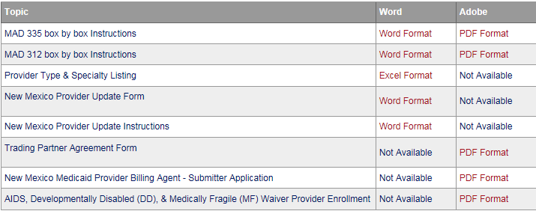
Update Requests
Update forms are found on the NM Medicaid Portal in the provider enrollment section and can be faxed to 505-246-9085.
https://nmmedicaid.portal.conduent.com/static/ProviderInformation.htm#ProviderEnrollment
Notes:
Coming soon: Providers will have the ability to submit update forms via the New Mexico Medicaid Web Portal!

Slide 69
Update Requests
Common Mistakes:
Submitting an application to cross reference an active provider to a group – An update form, rather than an application, should be submitted for cross referencing active providers. Conduent encourages providers to use the Provider Search function on the Web Portal to verify if the provider is active.
Missing Provider information - Include provider numbers or NPIs on all correspondence.

Slide 70
New Mexico Medicaid Resources
New Mexico Medicaid Online
Provider Information
Provider Login Screen Notices
Provider E-News Newsletters
Medicaid Provider Relations Call Center
Provider Communication Updates
Provider Field Representative
Provider Webinars
Open Forums and Live Training Sessions
Continued on next page . . .

Slide 71
New Mexico Medicaid Resources Continued
New Mexico Medicaid Portal – https://nmmedicaid.portal.conduent.com/static/index.htm
Claim Inquiries, Eligibility Verification, Electronic Claim Submission, Provider Manuals, E-News
NM Human Services Department – http://www.hsd.state.nm.us/mad/
Supplements, Memos, Provider Billing Packets and Policy
Medical Assistance Division – PE Program Staff – HSD.PEDeterminers@state.nm.us
Assistance with PE Applications, PE Determinations, MAD 070, PE Training, PE Certification
Consolidated Customer Service Center (CCSC) Helpdesk– (800) 299 - 7304.
Claim Status, Eligibility, Prior Authorization, Medicaid Updates
Consolidated Customer Service Center (CCSC) Helpdesk – NM.Providers@state.nm.us
Claim research assistance, general Medicaid inquiries, Provider Enrollment Applications, Forms & Instructions
HIPAA Helpdesk – HIPAA.desknm@state.nm.us
Assistance on NM Web Portal, EDI inquiries, and Online Claim Submission with DDE (Direct Data Entry)
Consolidated Customer Service Center (CCSC) Helpdesk – (800) 283-4465
Eligibility inquiries, Fee-for-Service Replacement Medicaid Identification Card, Enroll or change a Managed Care Organization and Eligibility application status
Medical Assistance Division, Program Rules – http://www.hsd.state.nm.us/providers/rules-nm-administrative-code-.aspx
NMAC for Programs administered by the Medical Assistance Division Yes New Mexico - https://www.yes.state.nm.us/yesnm/home/index Apply, check, update, or renew Medical Assistance (Medicaid) benefits

